Slide 1
GO FOR IT
Notes:
The Go for IT project was set up to provide digital Inclusion activities for people aged 50+ living in rural areas of Neath Port Talbot.
It has an important role to play to ensure that older people are not left behind in the digital age, so that they are able to obtain the full benefits of being online from accessing public services, shopping, switching fuel tariffs and keeping in touch with family via video chat. This enables older people to make full use of ICT to enhance their lives, thus reducing loneliness and isolation.

Slide 2
IT Programme Guide
The Internet – Browsers, Search Engines, Understanding Search Results.
Online Safety.
Setting up and using Email including downloading and sending attachments.
Shopping Online including Groceries, Amazon, Ebay
Selling Online
Accessing statutory services such as Council tax, ordering prescriptions, library books etc
Pay Pal – setting up and using an account
Social Media – Facebook & Twitter
Video Calling – Skype/Facetime/Facebook Messenger/Google Hangouts
Google Maps
PC Security & Safe Passwords
Catch Up TV
You Tube – and setting up your own account to upload videos
Downloading Apps
Notes:
The project started on 11th May.
It is a non-syllabus, user-led IT and communication skills programme.
The 14 points shown were topics of interest taken from the groups.
This programme guide gives the classes more of a structure, but as each session is tailored to the individual, it is their choice if they participate in the topic of the week or use the session as a drop in facility for a particular query.

Slide 3
Groups
Margam
Onllwyn
Glynneath
Tairgwaith
Notes:
Nine areas were identified for IT classes within the Neath Port Talbot area.
The first 4 areas have now completed their 15 week programme and from the evaluation forms that have been received they have all enjoyed and benefitted from the experience.

Slide 4
Margam Community Centre
Notes:
This class attracted 5 new learners.
They have found the information shared, beneficial and were happy to have the 1:1 support due to small class.
This photograph shows an identification quiz of all types of digital equipment. They were surprised at how much they already knew.

Slide 5
Ty Maes Marchog, Onllwyn
Notes:
This class is held in Ty Maes Marchog, Onllwyn.
Some of the learners live on site
Most of the learners live in the community
This class is well attended with a total of 17 learners. 10 female 7 male.
They are all over 65 and enjoy learning about new technology, new games, how to download apps, take photographs and manipulate them.
We have run the 15 week programme alongside a specialist programme of health and wellbeing. Each week this venue has IT, Exercise, Lunch and a speaker. Where possible I tailored the IT to compliment the afternoon topic.

Slide 6
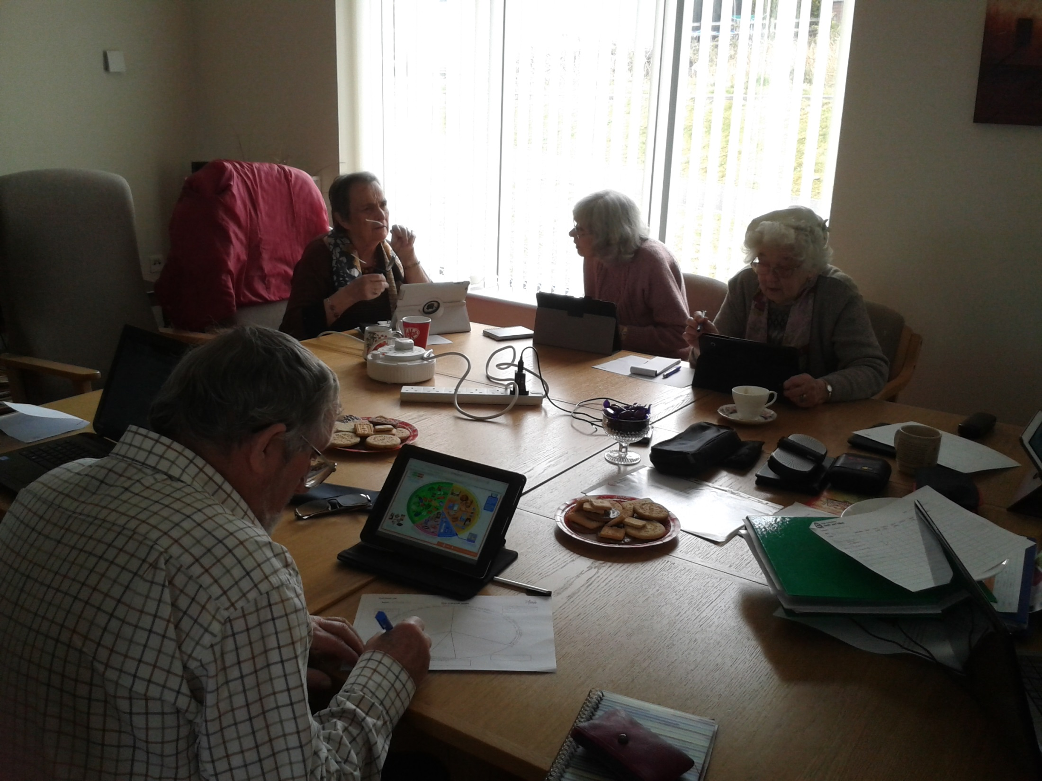
Notes:
Here the class are researching the food groups that make up the Eatwell Plate to give them a head start on the Nutrition presentation to follow.

Slide 7
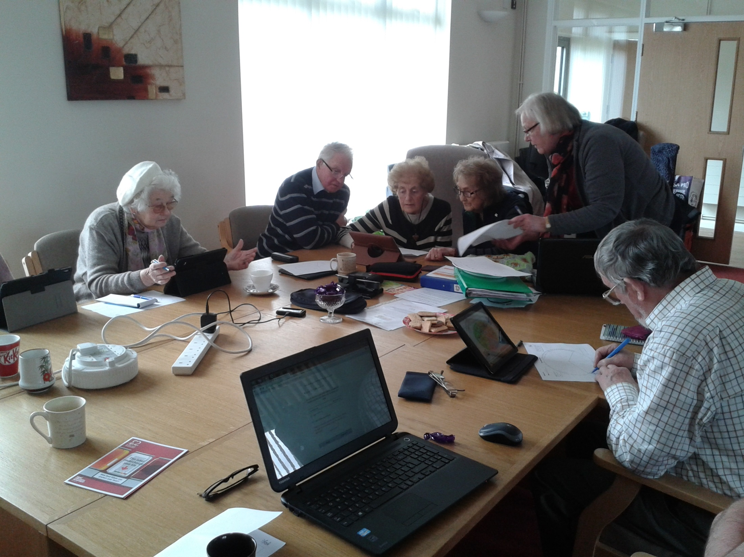

Slide 8
Learner Quotes
“I came for companionship and a chat, to have information on events. I have been encouraged to try out activities on the Kindle with help of a volunteer.”
Eiral – Ty Maes Marchog
“Tairgwaith is ideal to hold IT classes. Longer class time would be good. Tutor could do with extra help as we are all using different devices.”
Norma – Tairgwaith
“I am thoroughly enjoying the class. The tutor is very good. I would like it to go on forever! The venue is rather cold probably because it is so large. I look forward to learning something new every week. The tutor is very informative but also friendly and approachable.”
Pam – Glynneath
Notes:
This is what some of the learners had to say about the course so far.

Slide 9
Glynneath Town Hall
Notes:
Glynneath Town Hall
This was a taster session in preparation for the IT class which runs separately to the Morning Outreach group.
The ladies enjoyed experimenting with tablets taking photos of each other.

Slide 10
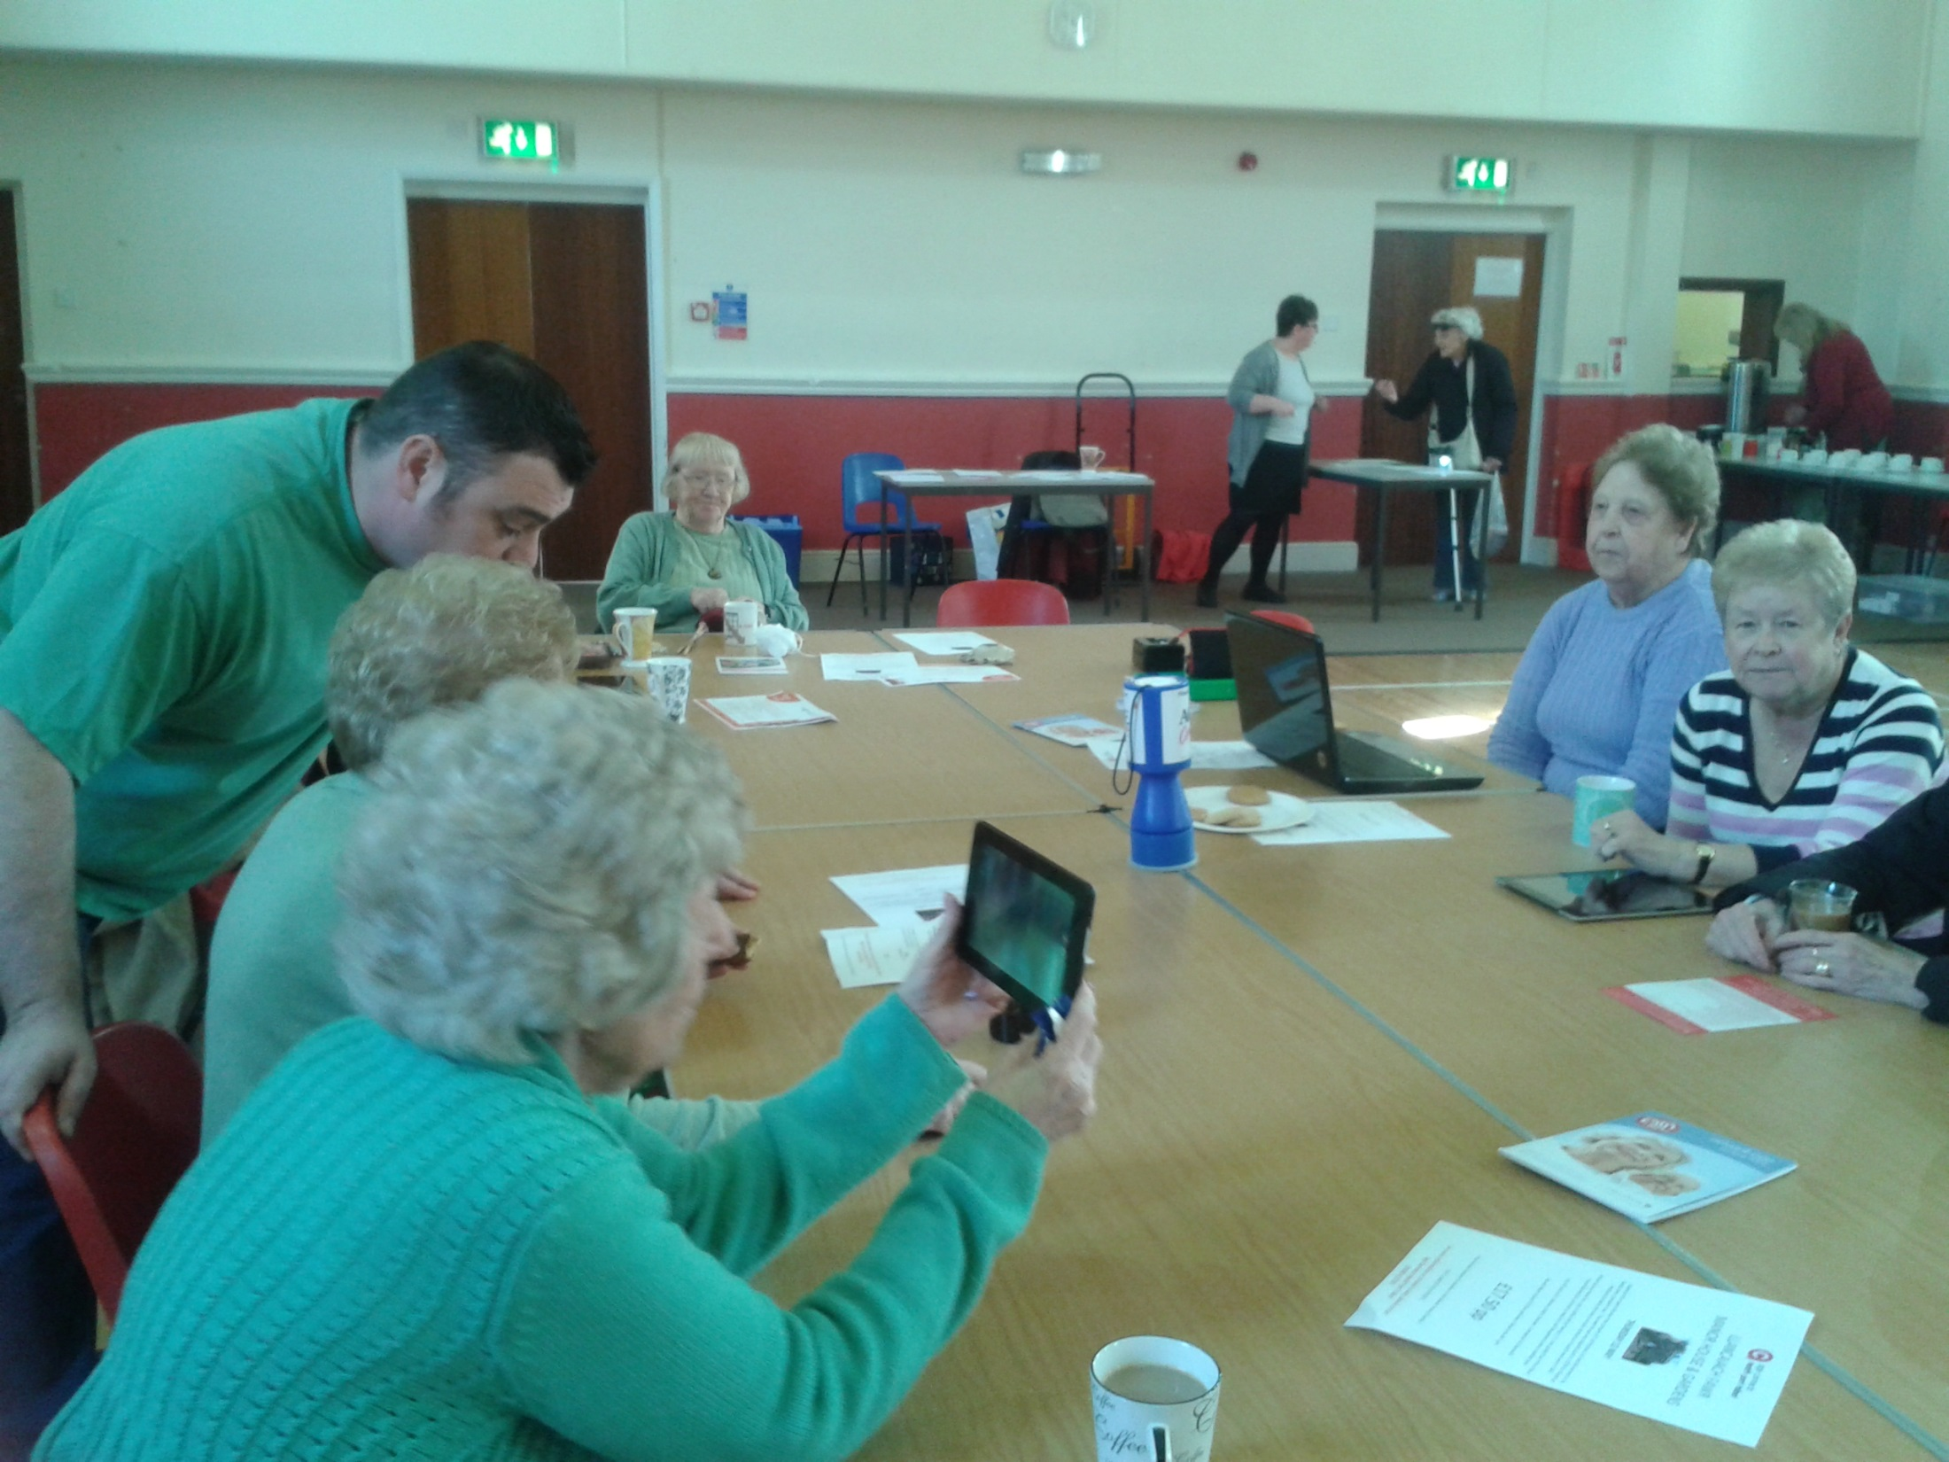

Slide 11
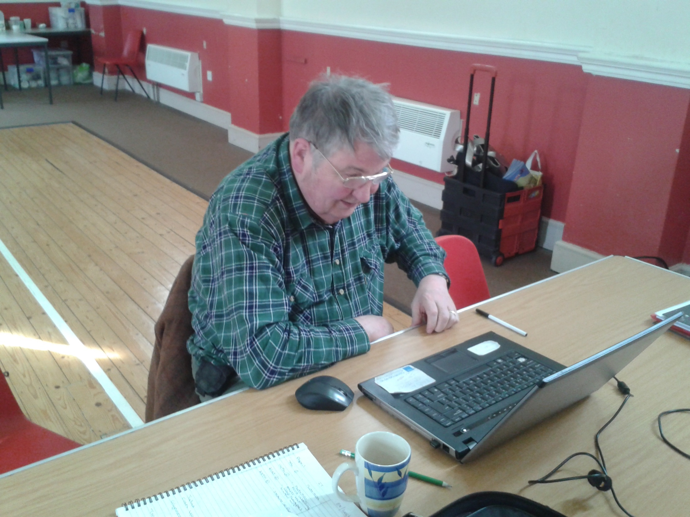
Notes:
The IT group has 9 regular members and is predominantly male.
The learners bring in their own equipment with an equal spread of tablets and laptops.
This group have gelled really well and are happy to share experiences and new websites, they have found.
They look forward to the social aspect of the class and at present are working on a group presentation of the history of faggots and peas since World War 2 – a topic chosen by themselves.

Slide 12
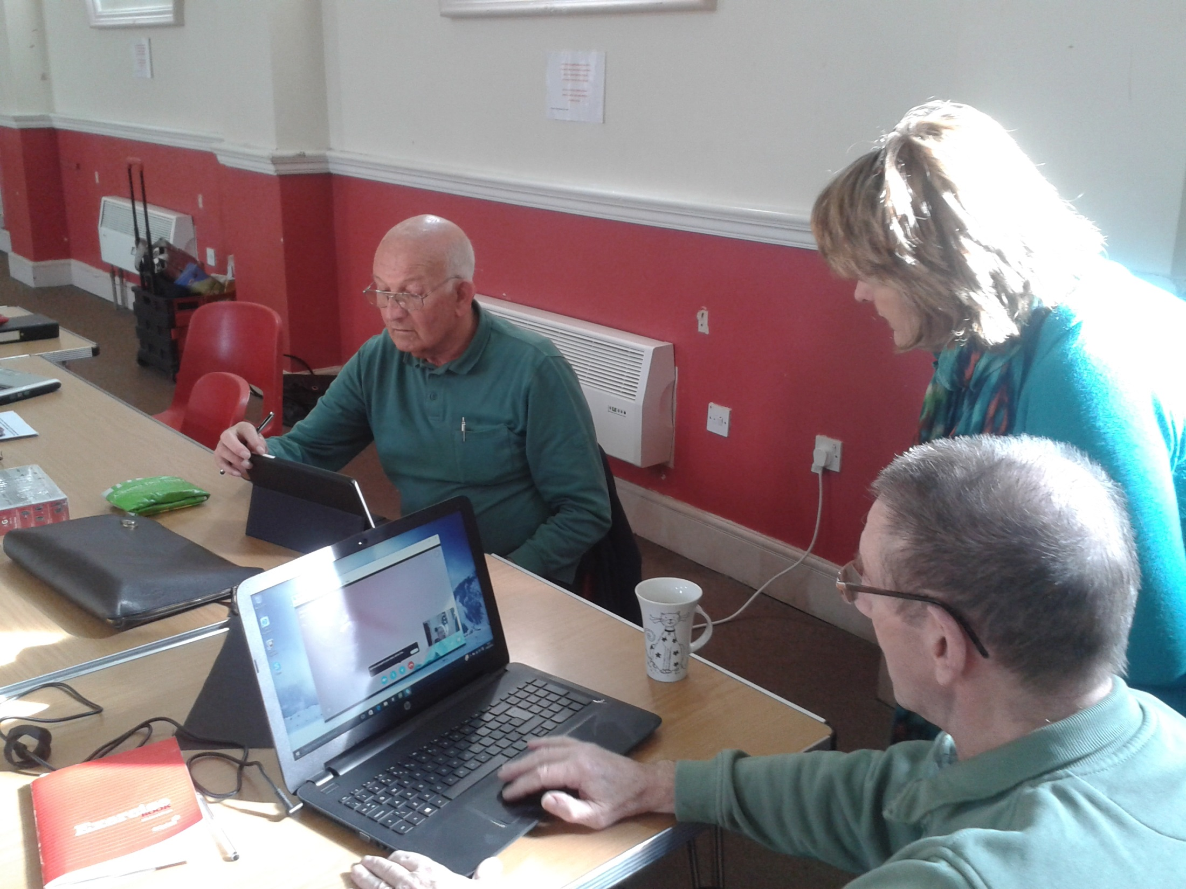

Slide 13
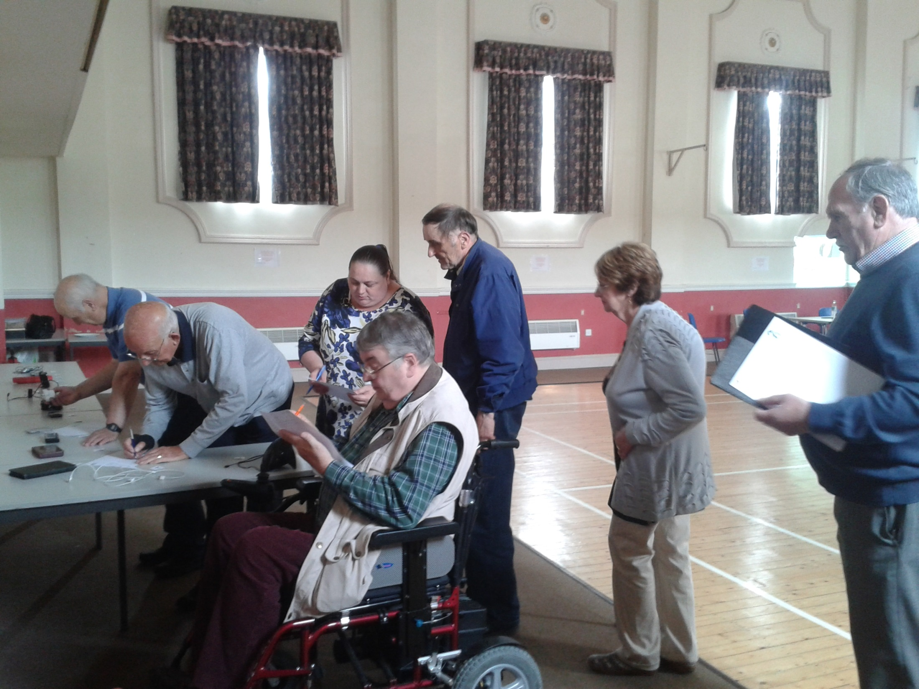
Notes:
Glynneath participating in the Identification Quiz.
Again they were surprised at the knowledge they already had by having gadgets at home.

Slide 14
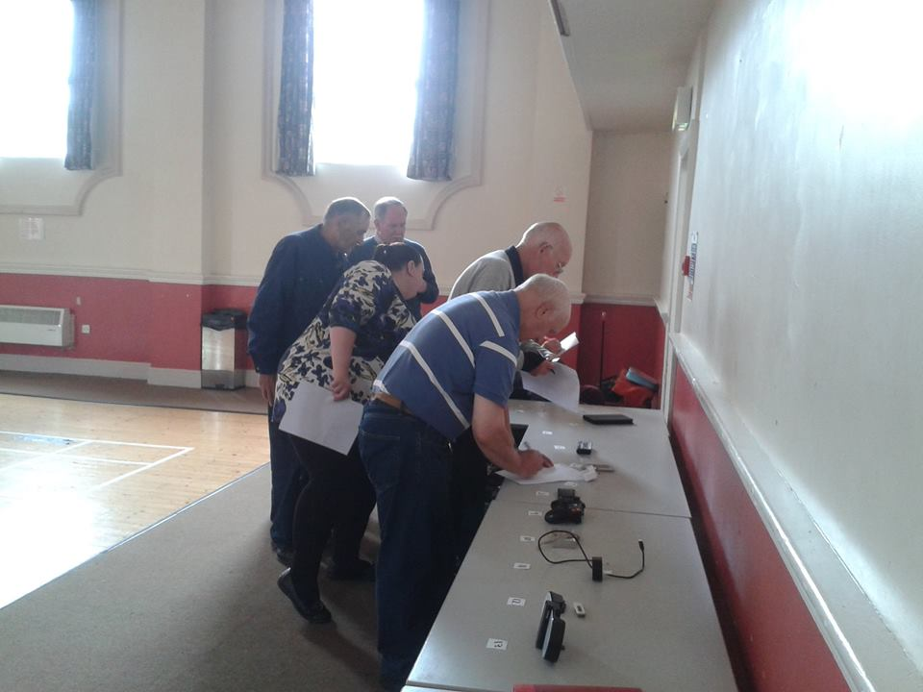

Slide 15
Canolfan Maerdy Tairgwaith
Notes:
As you can see from the photo the facilities in Tairgwaith are great.
An all female class with 60 % welsh speakers, making the class bilingual at times.
This class has enjoyed the social aspect of the course and have looked at online shopping, trip advisor, npt.gov as well as making new friends by having lunch together after the class at the onsite cafe.
Due to varying abilities and equipment the feedback from this group is that we would need to recruit some digital inclusion volunteers which we are in the process of doing.
This venue has a very strong youth club and we are hoping to run an intergenerational class with some of the interested youth signing up as our Digital volunteers.

Slide 16
New Groups
Seven Sisters
Glynneath
Pontardawe
Cwmgwrach
Notes:
The 15 week programme is going to rotate now to the other groups identified.
The next areas are Pontardawe, Seven Sisters, Cwmgwrach and Glynneath is going to continue until the next rotation.

Slide 17
Notes:
Here is a simple breakdown of the results from Term One of the Project.

